Slide 1
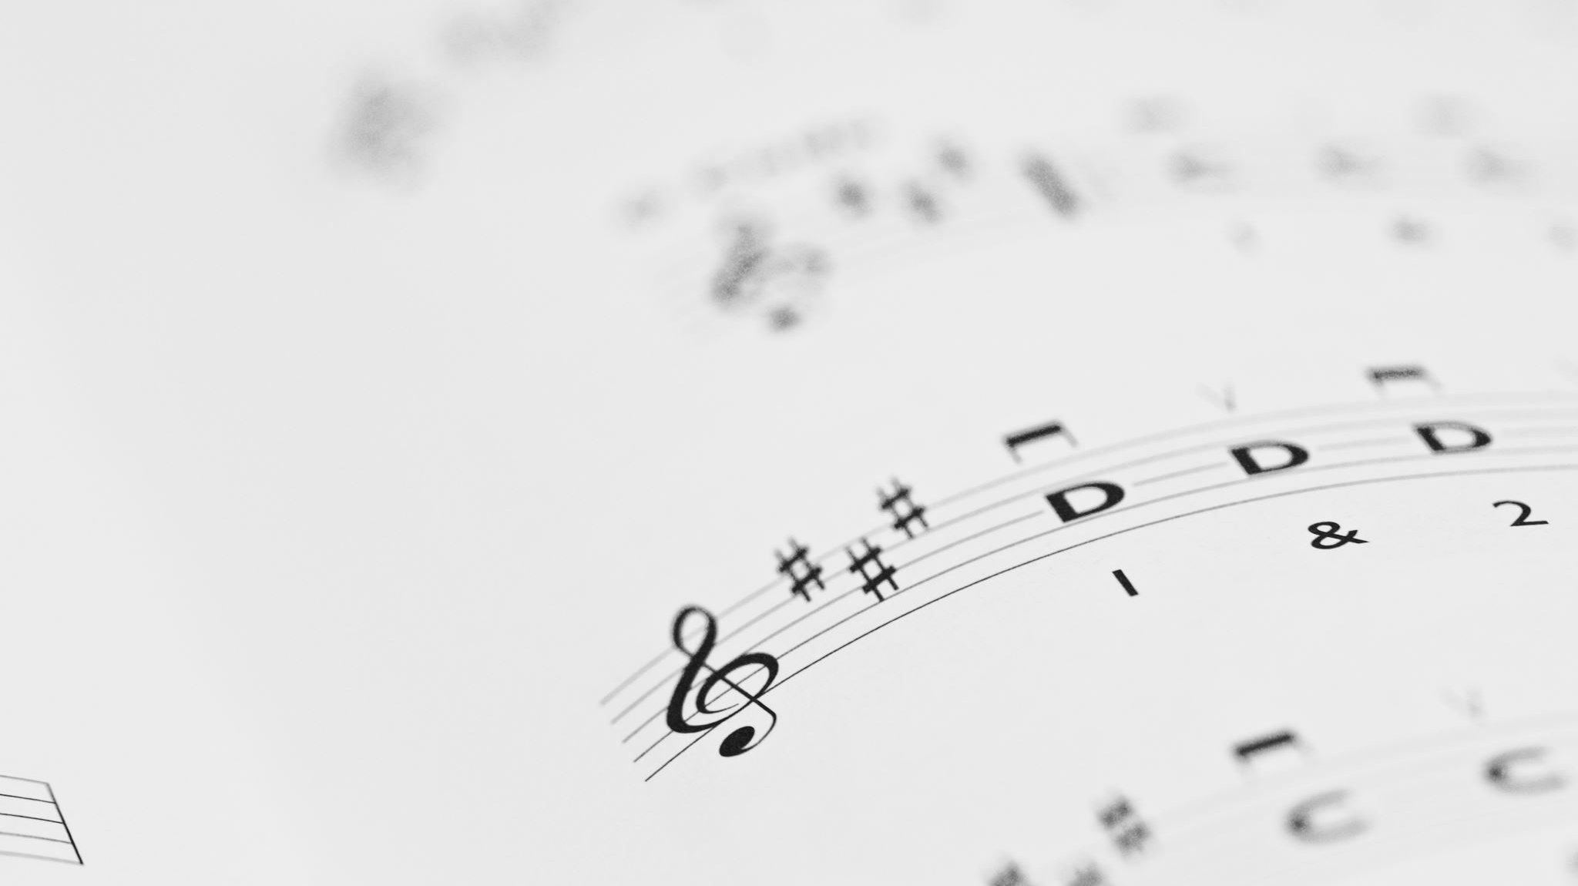
An analysis of sellers of vintage music instruments on ETSY
- PAULAMI GUHA

Slide 2


MOTIVATION OF RESEARCH
In a traditional marketplace a buyer can inspect products before buying.
Seller’s popularity, trustworthiness and honesty can be judged by physical transactions.
Sellers over the internet are difficult to judge.
Vintage musical instruments buyers are more selective and products are niche.
Research to look for factors that determine the popularity of a vintage musical instrument seller on Etsy

Slide 3
DATA METHODS
A seller’s popularity could be evaluated on the basis of the number of admirers (marked favorites) they have on Etsy. This can be analyzed on the basis of sales made so far, total reviews, shop rating, number of years active with Etsy, favorable shop policies, shipping time ,seller responsiveness and seller return score.
Null Hypothesis: Count of customers who have marked the seller as a favorite depends on sales made so far, number of total reviews, shop rating, total years active on Etsy, shopping policies , shipping time , seller responsiveness and seller return score.
Alternate Hypothesis: It does not depend on above factors .

Slide 4
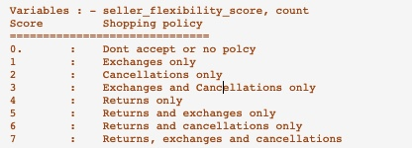
Data methods
Web scraping using Scrapy to locate variables for data analysis
Starting Page - Catalog Page (94 pages)
Product Page
Seller Name
Shipping Time
Seller Responsiveness
Seller Shopping Policies
Return Policies
Total Sales
Seller Page
Number of Years on Etsy
Total Reviews for Seller
Count of favorites (admirers) – Dependent Variable
Data was cleaned and finally had observations for 1,984 sellers.

Slide 5
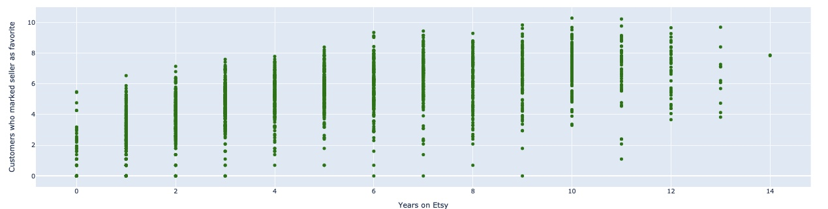
PLOTTING
Years on Etsy vs count of favorites

Slide 6
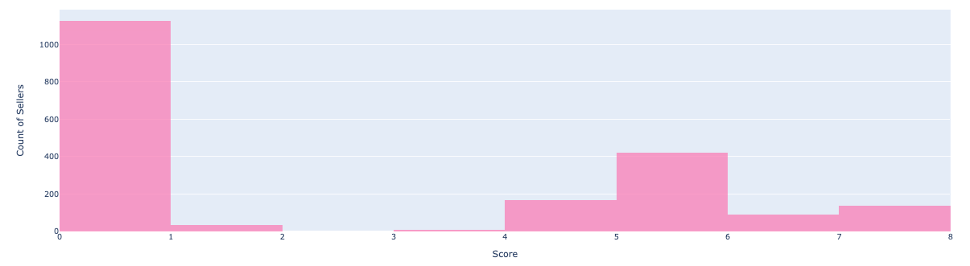
PLOTTING (CONT)
Frequency Distribution of seller flexibility score

Slide 7
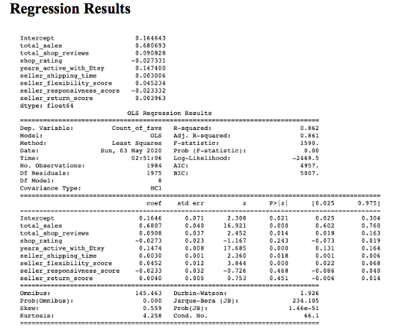
ECONOMETRIC MODEL

Slide 8
Analysis
Total sales, total shop reviews, number of years in Etsy, seller shipping time, seller responsiveness score came significant at alpha level 0.05.
Shop rating, seller responsiveness score and seller return score came as statistically insignificant.

Slide 9

conclusion
Useful to the Etsy admins to find out most popular sellers and also to provide feedback and incentives to seller and thus boost sales further.
Useful for those buyers of vintage musical instruments who would want to know the popularity of the seller based on the factors – total sales, total shop reviews , years active with Etsy, seller shipping time and seller flexibility score

